Slide 1
Passing data from an HTML page to a program
Dr Jim Briggs

Slide 2
Recap on HTTP/CGI architecture

Slide 3
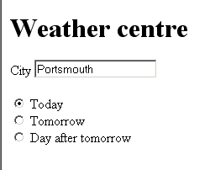
An example HTML form

Slide 4
HTML for example page
…
<FORM name="form1" method="GET" action="http://www.weather.co.uk/forecast">
<H1>Weather centre</H1>
<P>City <INPUT name="city" type="text" id="city" value="Portsmouth"> </P>
<P> <LABEL> <INPUT name="day" type="radio" value="today" checked> Today</LABEL>
<BR> <LABEL> <INPUT name="day" type="radio" value="tomorrow"> Tomorrow</LABEL>
<BR> <LABEL> <INPUT name="day" type="radio" value="dayafter"> Day after tomorrow</LABEL>
<BR> </P>
</FORM>
…

Slide 5
Passing data via HTTP: GET
If the method is GET:
data passed in the query string
Which would result in the request
GET www.weather.co.uk/forecast?city=Portsmouth&day=today HTTP/1.1
and in the location bar of the browser
http://www.weather.co.uk/forecast?city=Portsmouth&day=today

Slide 6
Passing data via HTTP: POST
If the method is POST:
data passed in the body of the message
Which would result in the request
POST www.weather.co.uk/forecast HTTP/1.1
... [headers]
city=Portsmouth&day=today
and in the location bar of the browser
http://www.weather.co.uk/

Slide 7
HTTP encoding
Queries
? separates path from query
& separates name/value pairs
= separates name and value
Both
+ for space
%xx for special characters (e.g. %7E for ~)

Slide 8
HTTP methods
Standard methods
OPTIONS
GET
HEAD
POST
PUT
DELETE
TRACE
CONNECT
Extension methods
Means of passing parameters:
GET passes parameters in query
POST passes parameters in body (or both)
From a browser:
Links (<A> tags) result in GET actions
FORMS can use either GET or POST or another method

Slide 9
"Safe"
Implementors should be aware that the software represents the user in their interactions over the Internet, and should be careful to allow the user to be aware of any actions they might take which may have an unexpected significance to themselves or others.
In particular, the convention has been established that the GET and HEAD methods SHOULD NOT have the significance of taking an action other than retrieval.
These methods ought to be considered "safe".
This allows user agents to represent other methods, such as POST, PUT and DELETE, in a special way, so that the user is made aware of the fact that a possibly unsafe action is being requested.
Naturally, it is not possible to ensure that the server does not generate side-effects as a result of performing a GET request; in fact, some dynamic resources consider that a feature.
The important distinction here is that the user did not request the side-effects, so therefore cannot be held accountable for them.

Slide 10
"Idempotent"
Methods can also have the property of "idempotence" in that (aside from error or expiration issues) the side-effects of N > 0 identical requests is the same as for a single request.
The methods GET, HEAD, PUT and DELETE share this property.
Also, the methods OPTIONS and TRACE SHOULD NOT have side effects, and so are inherently idempotent.
However, it is possible that a sequence of several requests is non-idempotent, even if all of the methods executed in that sequence are idempotent. (A sequence is idempotent if a single execution of the entire sequence always yields a result that is not changed by a re-execution of all, or part, of that sequence.) For example, a sequence is non-idempotent if its result depends on a value that is later modified in the same sequence.
A sequence that never has side effects is idempotent, by definition (provided that no concurrent operations are being executed on the same set of resources).

Slide 11
When to use which method?
Use GET for actions:
that are safe
that are idempotent
where the total length of the URI is less than 256 chars
where it's OK for the parameters to be visible to the user
where it's OK for the parameters to be preserved as part of a bookmark
Use POST for
everything else

Slide 12
Recap on HTTP/CGI architecture

Slide 13
Passing data via CGI
Environment variables
REQUEST_METHOD
CONTENT_LENGTH
QUERY_STRING
REMOTE_HOST
REMOTE_USER
Message body passed to stdin

Slide 14
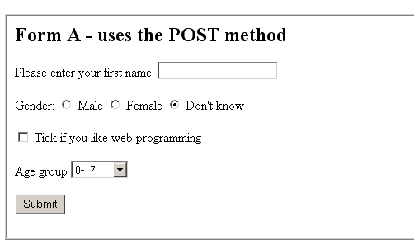
An HTML form

Slide 15
Example program
http://briggs.myweb.port.ac.uk/WEBP/notes/general/mynameis1.pdf

