Slide 1
Web architecture
Prof Jim Briggs

Slide 2
Introduction

Slide 3
What is the web?
Distributed system
Client-server system
Characteristics of clients and servers
Servers always on / Clients choose when on
Clients do not need high performance if the work is done on the server
Protocol based

Slide 4
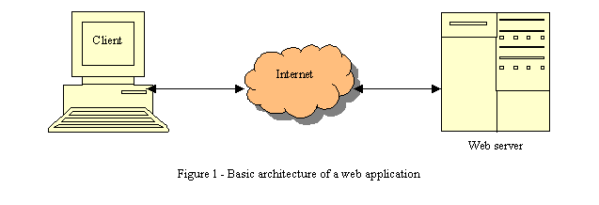
Basic architecture of the web

Slide 5
Common web tools
Browsers
Microsoft Edge
Mozilla Firefox
Google Chrome
Opera
Microsoft Internet Explorer
Safari
Netscape Navigator
Konqueror
Lynx
Servers
Apache
Internet Information Server (Microsoft)
nginx
Application servers

Slide 6
HTTP protocol
Specified by
IETF RFC 7230-7237
https://tools.ietf.org/html/rfc7230 etc
Was RFC 2616
http://www.w3.org/Protocols/rfc2616/rfc2616.html
Based on requests and responses
A response can contain any document
MIME (Multipurpose Internet Mail Extensions) types
http://www.iana.org/assignments/media-types/
A stateless protocol
Normally transported via a TCP/IP connection
Default port is TCP 80

Slide 7
HTTP requests
Requests
GET
POST
PUT
HEAD
Example request
GET http://www.port.ac.uk/index.htm HTTP/1.1

Slide 8
HTTP responses
HTTP/1.1 200 OK
Server: Microsoft-IIS/4.0
Date: Mon, 29 Apr 2002 08:50:53 GMT
Content-Type: text/html
Accept-Ranges: bytes
Last-Modified: Wed, 10 Apr 2002 16:12:34 GMT
ETag: "085fb85aae0c11:54fb"
Content-Length: 13845
<HTML>
<HEAD>
<TITLE>University of Portsmouth - Our University</TITLE>
...

Slide 9
An error response
HTTP/1.1 404 Object Not Found
Server: Microsoft-IIS/4.0
Date: Mon, 29 Apr 2002 08:58:12 GMT
Content-Length: 11891
Content-Type: text/html
<HTML>
<HEAD>
<TITLE>University of Portsmouth - Our University</TITLE>
...

Slide 10
Dynamic web pages

Slide 11
Dynamic web pages
Four models:
Server-side includes
CGI
Server modules
Auxiliary servers

Slide 12
Server side includes
Original technology
Tags in document processed by web server
Syntax
<!--#element attribute=value attribute=value ... -->
Example:
This file last modified <!--#echo var="LAST_MODIFIED" -->
Dangerous:
<!--#exec cmd="ls" -->

Slide 13
CGI architecture

Slide 14
CGI characteristics
Web server creates a new process for each request that maps onto a program
Data passed according to CGI
Server reads output of program from program
CGI spec:
https://datatracker.ietf.org/doc/html/rfc3875.html
Can use pretty much any programming language – best known Perl, Python, C/C++

Slide 15
Pros and cons of CGI
Pros:
Independent of server - if program crashes it cannot affect the server
The web server takes up less memory if it does not load any server modules
Any memory (or other resources) used by the CGI program is released when the CGI program terminates
Cons:
The time to create a new process to handle the CGI request is relatively long
For programs that access databases, each new process must establish a new database connection

Slide 16
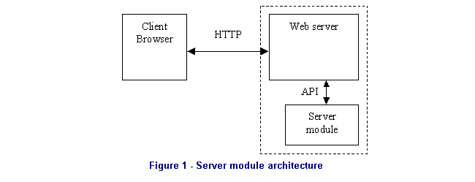
Server module

Slide 17
Server module characteristics
Web server invokes interpreter via API for each request that maps onto a program
Data passed via API
Server gets output via API
Popular for:
PHP
ASP.NET
Perl (as an alternative to CGI)

Slide 18
Pros and cons of server modules
Pros:
No need to create a separate process, therefore faster
For programs that access databases, the server can maintain a persistent connection to a database, saving reconnection time
Cons:
Server and program inextricably linked - a crash within the server module may crash the server
The web server will occupy more memory because of the size of the server module(s) it loads
If any server module needs a lot of memory, that memory will not be released (at least not until the server dies)

Slide 19
Auxiliary server

Slide 20
Auxiliary server characteristics
Auxiliary server runs on a different TCP/IP port (and potentially on a different machine)
Relevant requests forwarded by web server to auxiliary server
Server passes response back
Common for:
Java
PL/SQL (Oracle)

Slide 21
Pros and cons of auxiliary servers
Pros:
No need to create a new process for each request
Can maintain state (if desired) including database connections
Separate from the main web server
Cons:
Overhead of resending HTTP requests and responses

Slide 22
Big benefits of auxiliary servers
Enterprise scalability
add new web servers
add new auxiliary servers
cross-connect between them
fits in with database scalability
Resilience and reliability

Slide 23
Summary
Clients and servers
HTTP protocol
MIME types
Dynamic content
CGI
Server modules
Auxiliary servers

