Slide 1
Ajax
Prof Jim Briggs

Slide 2
Ajax
Asynchronous JavaScript And XML
Method of creating more interactive web applications
Moves more of the application to the client side
"Ajax: A New Approach to Web Applications", Jesse James Garrett
https://www.semanticscholar.org/paper/Ajax%3A-A-New-Approach-to-Web-Applications-Garrett/c440ae765ff19ddd3deda24a92ac39cef9570f1e

Slide 3
Ajax technologies
XHTML (or HTML), CSS, for marking up and styling information.
The Document Object Model (DOM) accessed with a client-side scripting language, especially ECMAScript implementations like JavaScript and JScript, to dynamically display and interact with the information presented.
The XMLHttpRequest object to exchange data asynchronously with the web server. In some Ajax frameworks and in certain situations, an IFrame object is used instead of the XMLHttpRequest object to exchange data with the web server.
XML is commonly used as the format for transferring data back from the server, although any format will work, including preformatted HTML, plain text, JSON and even EBML.

Slide 4
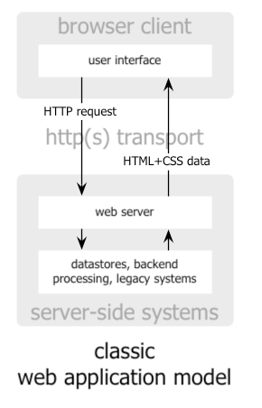

Slide 5
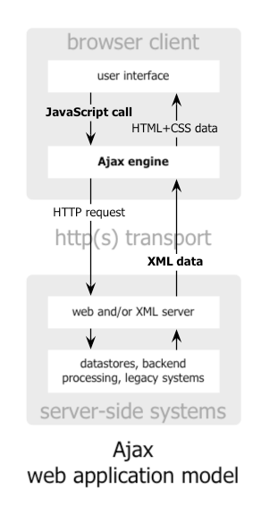

Slide 6
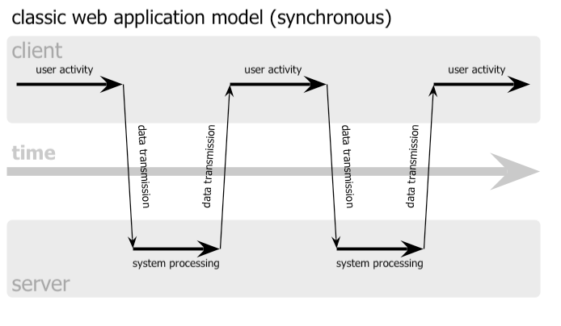

Slide 7
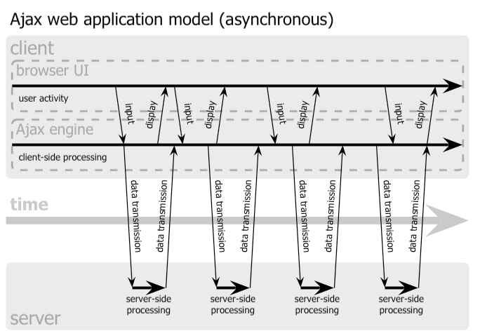

Slide 8
Ajax support in JSF
<f:ajax … /> tag
Three important attributes:
event: which one event should trigger action:
blur, change, click, dblclick, focus, keydown, keypress, keyup, mousedown, mousemove, mouseout, mouseover, mouseup, select, valueChange
click and valueChange are the defaults depending on the component
execute: which (several) components from the form should be updated on the server
render: which (several) components on the page should be updated after the request completes
execute/render wildcards:
@all, @none, @this, or @form
@this is default for execute
@none is default for render

Slide 9
Listener example
<f:ajax listener="#{mybean.someaction}" render="somecomponent" />
The following code represents the someaction method in mybean
public void someaction(AjaxBehaviorEvent event) { dosomething; }

