Slide 1
Software engineering tools for web development
Jim Briggs

Slide 2
Why use tools?

Slide 3
Computer aided software engineering (CASE)
Tools / workbenches / environments

Slide 4
Categories of CASE tools
Technical
Integrated development environment (IDE)
edit
compile
run
debug
Version control
Configuration control
Continuous integration
Requirements analysis
System design
Formal methods
Documentation
Text
Diagrams
Testing
Installation
Project management
Issue tracking
Resource management
Estimation
Planning
Metrics

Slide 5
Version control

Slide 6
What is version control?
Revision control / version control / source control
Manages changes to documents (e.g. program code)
Multiple versions of each file are stored (or recoverable)
Each version identified (usually by number)
Each user has a working copy of all/part of the data

Slide 7
Characteristics of version control systems
Repository model
distributed
client-server
shared folder
Concurrency model
lock
merge
History model
snapshot
change set
Change scope
tree
file
Accessibility
standard protocols
custom protocols

Slide 8
Some common version control systems
Open source/free:
CVS
Subversion
Mercurial
Git
Proprietary
Microsoft Visual SourceSafe
Perforce
Rational Change (IBM)

Slide 9
Subversion
Now an Apache project
http://subversion.apache.org/
Developed to "fix" problems with CVS
Features:
Versions directories as well as files
Copying, deleting and renaming are versioned
Atomic commits
Branches and tags are cheap
Can lock files
Works equally well with text and binary files
Costs are proportional to change size not data size

Slide 10
Conventional svn repository layout
/
/branches
/tags
/trunk

Slide 11
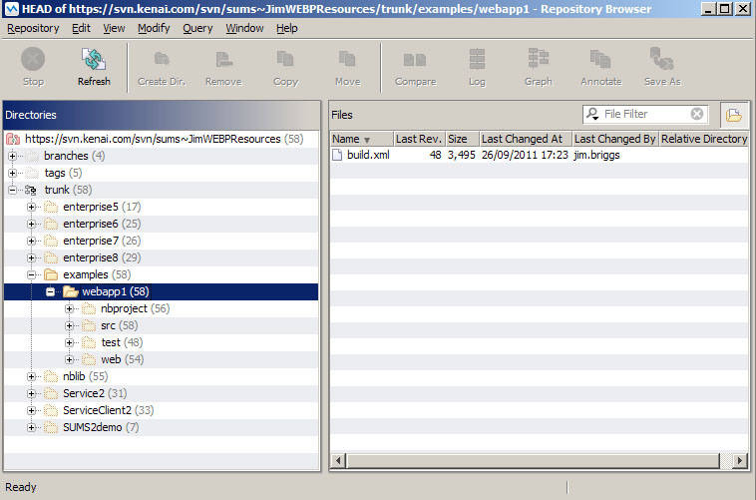

Slide 12
Issue tracking

Slide 13
What is issue tracking?
issue tracking / bug tracking / trouble ticket / support ticket / incident ticket systems
Keeps track of problems and their resolution
Can be used during development and/or customer relationship management

Slide 14
Characteristics of issue tracking systems
Means of input
GUI
web interface
email
web service
IDE integration
Workflow
fixed
customisable
Notification
email
RSS
Integration
IDE (in development systems)
CRM (in helpdesk systems)

Slide 15
Common issue tracking systems
Open source/free
Bugzilla
GNATS
JIRA
Trac
Proprietary
Microsoft Dynamics
Rational ClearQuest

Slide 16
JIRA
Developed by Atlassian
Java web app
Projects
Issues
a software bug, a project task, a helpdesk ticket, a leave request form, etc.
Features
Workflow (transition through statuses)
Time tracking
Reports
Dashboard
Process:
User submits issue
Manager actions issue
Staff resolves issue
Someone closes issue
Occasionally issue reopened

Slide 17
Integration

Slide 18
Integration
IDEs:
NetBeans
Eclipse
IntelliJ IDEA
Microsoft Visual Studio
Open source project hosts:
Kenai
Google Code
Sourceforge

Slide 19
Kenai
"Project Kenai is a connected developer destination where developers can host open source projects, as well as connect, communicate, and collaborate with developers of like mind."
Free to sign up
Free to start projects (up to 5)
Each project provides:
source code repository (Subversion, Git or Mercurial)
mailing lists / chat rooms / forums
project website / wiki
issue tracking (Bugzilla or JIRA)
NetBeans integration

