Slide 1
JavaServer Faces
Prof Jim Briggs

Slide 2
History
MVC pattern is a good thing
Web applications have lots of common features
Same flow of control (controller – model – view)
Input validation
Error responses
Security
Front Controller pattern is a good thing
Can we embody those features in a common "framework"?

Slide 3
Apache Struts
http://struts.apache.org
Dates from 2000
Framework assists in building the Controller component of a webapp
Also helps with the View (via some JSP taglibs)
Key classes in Struts 1
ActionServlet (almost never changed)
ActionForm
Action
ActionErrors
ActionForward
ActionMapping
struts-config.xml

Slide 4
Struts 2
Struts 2 has a different set of components to Struts 1
simplified structures; less inheritance; more POJOs
introduced 2008 (based on WebWork)
Major component pieces are:
Actions
Interceptors
Results
Packages
struts.xml
Annotations
Struts 2 tag libraries
Plug-ins

Slide 5
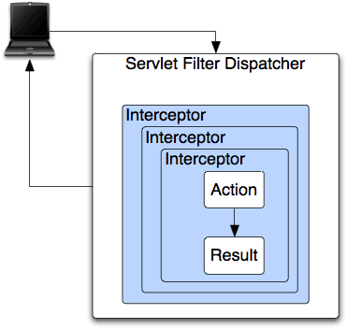
Struts 2 structure

Slide 6
JavaServer Faces (JSF)
Begun around 2004
Now adopted as the "official" Java EE MVC technology
Newest versions support Ajax

Slide 7
Distinctions between Struts and JSF
 | Struts: "action" framework | JSF: "component" framework
Approach | Maps URLs to activities on the back end Layout and workflow tends to be page oriented Close to the HTTP request cycle (although handles form for you) | Maps components and events Workflow more like a desktop application Hides framework well
Relationship to code | Tend to be "thinner" in how they stand between your code and the raw HTTP request | Can be more approachable, but more complex to understand if framework starts getting in the way
Better for … | Action frameworks are better for "web sites": sites that focus on delivering content to the user where it's mostly a "read only" experience for the end user user likely to want to bookmark things, come back to arbitrarily deep pages, etc. | Component frameworks are better for "web apps": CRUD screens, back office applications, lots of forms and controls, etc. where the workflow is more controlled where tend not to get to a "detail" screen without going through the "list" or "header" screen first don't bookmark well, HATE the "refresh button", may behave poorly with the back button, etc.
State | No state saved | Saves state on server and restores it on next request

Slide 8
JSF specifics

Slide 9
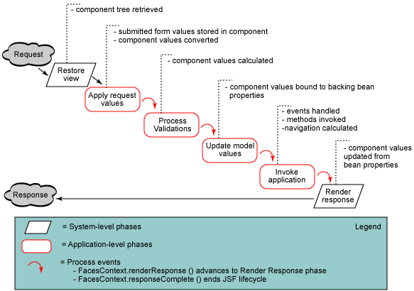
JSF lifecycle

Slide 10
JSF basics
HTML vs XHTML
Facelets XHTML as the preferred form of JSF page
JSP is also an option, but rarely used
XML namespaces
Backing Beans (@Named – was @ManagedBean)
Managed Properties
JSF component tag libraries (and common prefix)
html h
core f
facelets ui
composite
core c (from JSP)
functions fn (from JSP)
Implicit objects

Slide 11
JSF events and processing
FacesServlet
faces-config.xml configuration file
Events are implemented as Backing Bean methods
Navigation between pages
Message (error) handling
Conversion
Validation
Ajax support

Slide 12
JSF HTML tag library <h: >
h:body
h:button
h:column
h:commandButton
h:commandLink
h:dataTable
h:form
h:graphicImage
h:head
h:inputHidden
h:inputSecret
h:inputText
h:inputTextarea
h:link
h:message
h:messages
h:outputFormat
h:outputLabel
h:outputLink
h:outputScript
h:outputStylesheet
h:outputText
h:panelGrid
h:panelGroup
h:selectBooleanCheckbox
h:selectManyCheckbox
h:selectManyListbox
h:selectManyMenu
h:selectOneListbox
h:selectOneMenu
h:selectOneRadio

Slide 13
JSF Core tag library <f: >
f:actionListener
f:ajax
f:attribute
f:convertDateTime
f:convertNumber
f:converter
f:event
f:facet
f:loadBundle
f:metadata
f:param
f:phaseListener
f:selectItem
f:selectItems
f:setPropertyActionListener
f:subview
f:validateBean
f:validateDoubleRange
f:validateLength
f:validateLongRange
f:validateRegex
f:validateRequired
f:validator
f:valueChangeListener
f:verbatim
f:view
f:viewParam

Slide 14
JSF Component library <ui: >
ui:component
ui:composition
ui:debug
ui:decorate
ui:define
ui:fragment
ui:include
ui:insert
ui:param
ui:remove
ui:repeat

