Slide 1
Introduction to Java web programming
Prof Jim Briggs

Slide 2
Java technology
Concept of a Java Virtual Machine (JVM)
Portability
Three kinds of Java program
Applications
Applets
Servlets

Slide 3
Auxiliary server

Slide 4
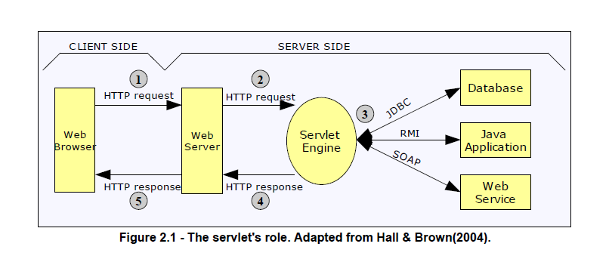
Architecture of a Java web application

Slide 5
Servlet
Mini program created when the servlet container first receives a request that maps onto it
A servlet services a request via a thread
Servlet object continues to exist until container closes down

Slide 6
Threads (digression) What's the output of this program?
Thread t1
x = 7;
print x;
x = x + 1;
print x;
Thread t2
x = 12;
print x;
x = x – 3;
print x;

Slide 7
Answers
7 8 12 9
12 9 7 8
7 12 13 10
12 7 4 5
… and many more
If your program depends on one of these being "correct", then you have a race condition bug

Slide 8
Typical functions of a servlet
Validate data input to it via HTTP request parameters
Perform some business function using that data
Decide what view the user should next see
Generate that view as an HTTP response

Slide 9
Servlet container
Program that implements the Java servlet specification (and others)
Part of the Java Enterprise Edition (Java EE)
Reference implementation used to be Tomcat (an Apache project: http://tomcat.apache.org/)
Full Java EE reference implementation now is Glassfish (http://glassfish.java.net/)
Other implementations are available:
JBoss/WildFly

Slide 10
Functions of servlet container
Listen for HTTP requests
Decode HTTP request and decide which application and servlet it is intended for
Call servlet, passing request and response objects
Encode HTTP response and send it

Slide 11
Mapping URLs to servlets
Consider the URL:
www.myserver.com/myapp/myservlet
Container must break this down
www.myserver.com: virtual host
/myapp: context or web application
/myservlet: address within web application

Slide 12
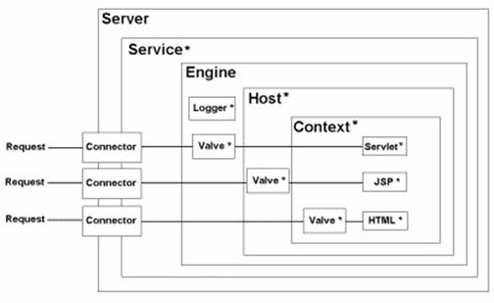

Slide 13
Web applications
A container may run several (independent) web applications (webapps)
Each must have a WEB-INF directory:
web.xml configuration file
classes directory
lib directory

Slide 14
Brief history of JWP
Servlets
JavaServer Pages (JSP)
Various MVC technologies (including Apache Struts)
JavaServer Faces (JSF)

Slide 15
Important classes and interfaces 1
All servlets must implement the Servlet interface
Class HttpServlet
init/destroy
doGet/doPut
Your servlet will derive from this

Slide 16
Important classes and interfaces 2
2 parameters to a request handling method
Class HttpServletRequest
String param = request.getParameter(name);
Class HttpServletResponse
PrintWriter out = response.getWriter();
Class HttpSession
Holds data common to related requests

Slide 17
JavaServer Pages (JSP)
Distinction:
servlets: HTML embedded in program
JSP: program embedded in HTML
JSP useful where majority of effort is page design
Translated automatically into a servlet
Retranslated if changed (no need to restart server)
Can be placed anywhere in a web application
but not visible to client if in the WEB-INF directory

Slide 18
JSP elements
Scriptlets
Actions
Directives
Standard tags
Custom tags
Expression language

Slide 19
Scriptlets
Any Java code between <% … %>
Expressions
<%= name %>
Declarations
<%! String name %>
DEPRECATED
Do not use - not XML
Much easier to use JSTL

Slide 20
Actions
Including other files
<jsp:include page="path"/>
Request time inclusion
Accessing beans
<jsp:usebean id="beanName" class="package.class" scope="session"/>
<jsp:getproperty name="beanName" property="propertyName"/>
<jsp:setproperty name="beanName" property="propertyName" value="newValue"/>

Slide 21
Directives
Page directive
<%@page import="package.class"%>
<%@page contentType="text/html"%>
<%@page errorPage="URL"%>
Include directive
<%@include file="filename"%>
Translation time inclusion

Slide 22
Standard tags
Java Standard Tag Library (JSTL)
Taglib directive
<%@ taglib prefix="c" uri="http://java.sun.com/jstl/core" %>
Core
<c:out value="${anExpression}"/>
SQL
XML
Format

Slide 23
Custom tags
Implement your own tags
Create a Tag Library Definition (tld) file
Extend predefined classes
Specify your library in a @taglib directive
Use like JSTL tags

Slide 24
Expression language
Refer to Java Beans and other common classes
${expression} can appear as tag attributes or (since JSP 2.0) in the page itself
Several implicit objects:
header
${header["user-agent"]}
param
${param['name']}
${param.name}

Slide 25
Deferred evaluation
EL originally conceived as a read-only notation
${expression} reads value of property
JSF (see later) also requires ability to update values
EL therefore added deferred evaluation of expressions
Syntax: #{expression}

