Slide 1
Introduction to servlets and JSP
Dr Jim Briggs

Slide 2
Java technology
Concept of a Java Virtual Machine (JVM)
Portability
Three kinds of Java program
Applications
Applets
Servlets

Slide 3
Auxiliary server

Slide 4
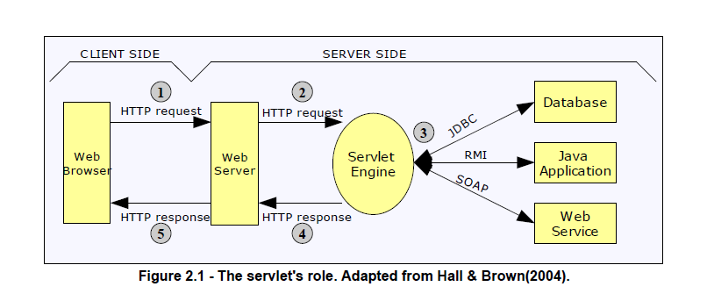
Architecture of a Java web application

Slide 5
Servlets
Created when the servlet container first receives a request that maps onto it
Servlet services request via thread
Servlet object continues to exist until container closes down

Slide 6
Advantages of servlets over CGI 1
more efficient
the same process handles each HTTP request
code is loaded into memory only once
only a new thread is created for each request
servlets remain in memory when completed so it is straightforward to store data between requests
more convenient
there is an extensive infrastructure for: decoding form data
reading and setting HTTP headers
handling cookies
tracking sessions
accessing databases

Slide 7
Advantages of servlets over CGI 2
more powerful
servlets can talk directly to the web server (makes redirection possible)
multiple servlets can share data
maintain information from request to request
more portable
very strong standard API makes porting servlets between implementations is very easy
inexpensive (but then so are many CGI tools!)
the J2EE is made available by Sun free of charge
Tomcat is available free from Apache

Slide 8
Advantages of servlets over CGI 3
more secure
not run via an operating system shell (that might treat some characters specially)
Java is not susceptible to buffer overflow attacks like C/C++
more mainstream
proven technology
supported by major companies like IBM, Oracle, Sun, Macromedia
runs on many operating systems
used by many large companies

Slide 9
Servlet container
Program that implements the Java servlet and JSP specifications
Part of the Java 2 Enterprise Edition (J2EE)
Reference implementation used to be Tomcat (an Apache project)
Full J2EE reference implementation now is Glassfish

Slide 10
Mapping URLs to servlets
Consider the URL:
www.myserver.com/myapp/myservlet
Container must break this down
www.myserver.com: virtual host
/myapp: context or web application
/myservlet: address within web application

Slide 11
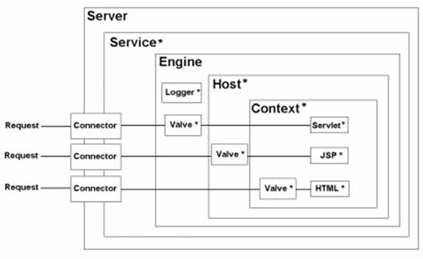

Slide 12
Web applications
A container may run several (independent) web applications (webapps)
Each must have a WEB-INF directory:
web.xml configuration file
classes directory
lib directory

Slide 13
Important classes and interfaces 1
All servlets must implement the Servlet interface
Class HttpServlet
init/destroy
doGet/doPut
Your servlet will derive from this

Slide 14
Important classes and interfaces 2
2 parameters to a request handling method
Class HttpServletRequest
String param = request.getParameter(name);
Class HttpServletResponse
PrintWriter out = response.getWriter();
Class HttpSession
Holds data common to related requests

Slide 15
Example servlets
hello
HelloYou
HelloMime

Slide 16
JavaServer Pages (JSP)
Distinction:
servlets: HTML embedded in program
JSP: program embedded in HTML
Useful where majority of effort is page design
Translated automatically into a servlet
Retranslated if changed (no need to restart server)
Can be placed anywhere in a web application
but not visible to client if in the WEB-INF directory

Slide 17
JSP elements
Scriptlets
Actions
Directives
Standard tags
Custom tags
Expression language

Slide 18
Scriptlets
Any Java code between <% … %>
Expressions
<%= name %>
Declarations
<%! String name %>
DEPRECATED
Do not use - not XML
Much easier to use JSTL

Slide 19
Actions
Including other files
<jsp:include page="path"/>
Request time inclusion
Accessing beans
<jsp:usebean id="beanName" class="package.class" scope="session"/>
<jsp:getproperty name="beanName" property="propertyName"/>
<jsp:setproperty name="beanName" property="propertyName" value="newValue"/>

Slide 20
Directives
Page directive
<%@page import="package.class"%>
<%@page contentType="text/html"%>
<%@page errorPage="URL"%>
Include directive
<%@include file="filename"%>
Translation time inclusion

Slide 21
Standard tags
Java Standard Tag Library (JSTL)
Taglib directive
<%@ taglib prefix="c" uri="http://java.sun.com/jstl/core" %>
Core
<c:out value="${anExpression}"/>
SQL
XML
Format

Slide 22
Custom tags
Implement your own tags
Create a Tag Library Definition (tld) file
Extend predefined classes
Specify your library in a @taglib directive
Use like JSTL tags

Slide 23
Expression language
Refer to Java Beans and other common classes
${expression} can appear as tag attributes or (since JSP 2.0) in the page itself
Several implicit objects:
header
${header["user-agent"]}
param
${param['name']}
${param.name}

Slide 24
Web programming languages
Programmatic
Output HTML in print statements
Use normal programming language constructs
Examples:
Perl
Java (servlets)
C/C++
Better when the complexity is in the data capture and processing
Output-based
HTML page with programming statements embedded
Can require contrived programming language constructs
Examples:
PHP
ASP
Java (Java Server Pages)
Better when the complexity is in the output format

