Slide 1
Structure of a web application
Prof Jim Briggs

Slide 2
MVC

Slide 3
MVC
Model View Controller pattern
Way of keeping aspects of an application separate
Applicable to all applications, not just web ones

Slide 4
Advantages of MVC
Good software engineering practice to maintain separation of concerns
An application might have more than one user interface
The elements of the user interface need to be kept separate from the parts that are common to each
Different developers (with different skills) may be responsible for different aspects of the application
Frequently, user-interface designers responsible for the view
Conventional programmers responsible for the controller and model
In some circumstances, the controller might be the responsibility of an interaction engineer (or team)

Slide 5
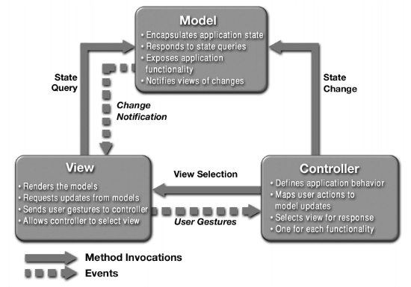
The structure of MVC

Slide 6
Implementing webapps in Java
Type 1 – all in JSP
Type 1.5 – JSPs that call JavaBeans to do most of the processing
Type 2 – very little code in JSPs; servlet used as controller; JavaBeans provide model

Slide 7
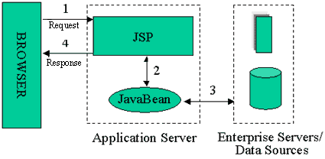
Type 1.5

Slide 8
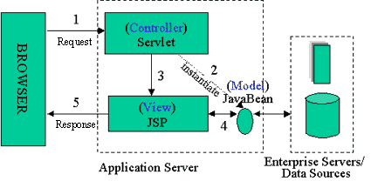
Type 2

Slide 9
Application layers

Slide 10
3-tier Application Architecture
3-tier architecture
External
Presentation
User
Business Logic
Other Apps
Database
Data Access

Slide 11
Presentation Layer
3-tier architecture
This is what the user sees and interacts with
Sometimes called the GUI or client view
Should not contain business logic or data access code
Presentation
Business Logic
Data Access

Slide 12
Logic (Business) Layer
3-tier architecture
The set of rules for processing business information
Sometimes called middle tier or backend
Should not contain presentation or data access code
Presentation
Business Logic
Data Access

Slide 13
Data Access Layer
3-tier architecture
The physical storage layer for data persistence
Manages access to DB or file system
Should not contain presentation or business logic code
Presentation
Business Logic
Data Access

Slide 14
The 3-tier principles
3-tier architecture
Each tier should be independent and should not expose dependencies related to the implementation
Unconnected tiers should not communicate
Presentation
Business Logic
Data Access

Slide 15
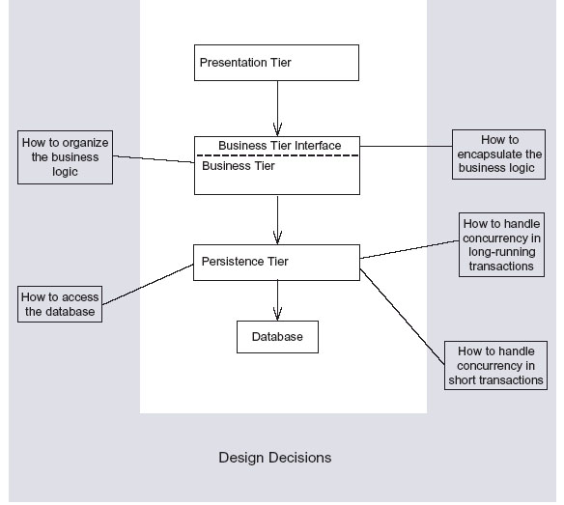
How tiers affect design

Slide 16
Implementation architectures

Slide 17
Single server (abstract)
Application
User
Web server
Persistence
Business objects
Database
Business logic
Controller
View

Slide 18
Single server (servlet/JSP)
Application
User
Web server
Façade classes
Entity beans
Database
Session beans
Servlets
JSPs

Slide 19
Single server (JSF)
Application
User
Web server
Façade classes
Entity beans
Database
Session beans
Backing beans
Facelets

Slide 20
Separate servers (abstract)
Application
User
Web server
Database
Controller
View
Application server
Business logic
Business objects
Persistence

Slide 21
Separate servers (servlets/JSP)
Application
User
Web server
Database
Servlets
JSPs
Application server
Session beans
Entity beans
Façade classes

Slide 22
Separate servers (JSF)
Application
User
Web server
Database
Backing beans
Facelets
Application server
Session beans
Entity beans
Façade classes

Slide 23
Java Beans

Slide 24
JavaBeans
A JavaBean is a Java class that:
has a parameterless constructor
(it could have other constructors as well)
is capable of holding state through one or more private instance variables
(and if necessary saving it to a persistent store)
implements a method called getX that returns the value of readable property X
implements a method called setX that changes the value of writable property X
(has both a setter and a getter for a read/write property)
may also fire, and respond to, events
(but that ability is not important for our purposes at the moment)

Slide 25
Enterprise JavaBeans
Entity beans
Session beans
Stateless
Stateful
Singleton
Message beans
Dependency injection
State management
Transaction management
Security
Pooling
Interceptors

