Slide 1
Web services
Dr Jim Briggs

Slide 2
Evolution of electronic interaction
Web Services is the next step in the automation of inter-enterprise interaction
Web Browsing
Human travel agent provides “organise holiday” service by surfing the web to look for and invoking services – book a hotel; book a plane; book a car hire; ….; confirm bookings of best options to meet client needs
Web Services
The aspiration of Web services is to provide a framework that allows that same model to be used in writing an application – which is itself becomes an “organise a holiday” service, finding and using useful services

Slide 3
Human interaction
 | Service provider | Service consumer
E-mail | Yes | Yes
Web browsing | No | Yes
Web services | No | No

Slide 4
Service Interaction
I organise
holidays
I know
the weather
Get a car rental quote
locate service
ask for quote
Is quote good enough?
Yes
Reserve car, provisionally
… get other resources reserved
Confirm reservation
Service Identifier
I locate services
quote
I book car
Rentals
I book hotels
I convert
currency
I book planes

Slide 5
Essential requirements
Need to achieve effective cooperation even though
the different services are
produced by different organisations,
without any design collaboration,
on different platforms
Requires “interoperability”
the services are autonomously evolving
Requires Loose Coupling

Slide 6
Coupling
COUPLING – about intensity of communication
Execution Coupling:
Frequency and extent of communication relative to processing
telephone conversation is tightly coupled, e-mail conversation is loosely coupled
For web services – very loose coupling
Interaction of order of a second
Whereas centralised object invocation – micro-seconds
Coarse granularity – do enough work in a service request to justify the time taken by the communication overhead
Design Coupling:
How much design knowledge has to be communicated between the designers of the software at the two ends of an interaction
Which they then build into their software
The extent of statically shared knowledge between two ends of an interaction

Slide 7
Loose Design Coupling
Loose (Design) coupling – minimum prior shared information between the designer of the two components of an interaction
Dynamically accessible Machine processable Meta data
Self-describing data in standard format – XML documents
Description of structure of communications – SCHEMAS (types)
Service description – WSDL, using SCHEMAS for message structure
Means for obtaining it – from a repository, using standard such as UDDI
Communication protocol that supports this – SOAP
Everything is a SCHEMA-described XML document – soap message, WSDL definition, schemas themselves (meta-schema)
Tolerance of partial understanding
Schemas allows extension points – one participant may have an older WSDL definition which accommodates extensions with additional information

Slide 8
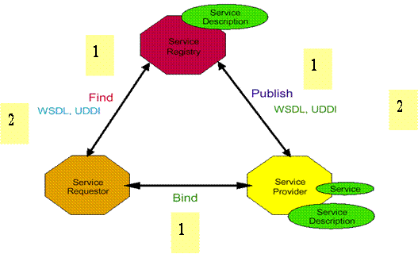
Publish and subscribe architecture

Slide 9
Web service standards
XML
SOAP
Simple Object Access Protocol
message protocol
WSDL
Web Services Description Language
defines format of messages
UDDI
Universal Description Discovery and Integration
"Yellow Pages"

Slide 10
Implementation in Java EE

Slide 11
Java web services specifications
JAXB 2.2 (JSR 222)
API for handling XML objects
JAX-WS 2.2 (JSR 224 - replaces JAX-RPC 1.0 (JSR 101))
APIs and annotations for WS
Handles all low-level processing (including XML)
Web Services 1.2 (JSR 109)
Defines container behaviour
WS-Metadata 2.0 (JSR 181)
Maps Java interfaces to WSDL
JAXR 1.0 (JSR 93)
Java client access to UDDI

