Slide 1
Access control and user management in Apache

Slide 2
Apache access control
Include appropriate module:
mod_auth for basic authentication
mod_digest for digest authentication
mod_authz_host for access control by host
Access control can be:
Site wide
usually set up in the httpd.conf file
Per directory – often using an "access control file"
Unix: .htaccess
Windows: htaccess.hta
Access control files need to be protected themselves, especially when used per directory

Slide 3
Access control policy
Access control needs designing
What should go in the httpd.conf file site-wide?
What do you want to be mandatory and not permit users to change?
For per directory controls:
who can control access to their own bit?
who can add/remove/manage users?
who can overrule site-wide structures?
Beware a proliferation of userIDs/passwords

Slide 4
Access by user
Access control usually on a "per directory" basis
Need to be able to override site-wide control
Configured on a "realm" basis
htaccess.hta file might be:
AuthName "RogerSecrets"
AuthType Basic
AuthUserFile "N:/WebRoot/Users/users.pwd"
require valid-user

Slide 5
Require option
Require can be general or specific:
require valid-user
require user martin jane
Users can be grouped
Need a group file – plain text
staff: martin jane
You can require a specific group of users, e.g.
require group staff

Slide 6
Access by host 1
Restrict access by host using allow and deny
The order directive specifies which rule to apply first:
Order allow,deny
When you want to let most hosts in but keep a few out
Order deny,allow
When you want to keep most hosts out and let a few in
Order mutual-failure
When you want to let in only those on the allow list and who are not on the deny list – not very common!

Slide 7
Access by host 2
Example: setup so access to directory admin can be from your office PC or home PC (assume fixed IP)
<Directory "N:/WebRoot/Roger/htdocs/admin">
Order deny,allow
Deny from all
Allow from 148.192.255.5 155.6.122.9
</Directory>

Slide 8
Mixing access controls
User access control and host access control can be applied to the same site/directory
Satisfy directive tells Apache how to mix the rules:
satisfy any
either host or user (id/password) valid
satisfy all
must be valid user and from a permitted host

Slide 9
User management
Need a database of user name/password pairs
A flat file is easy for small numbers of users
For larger user bases, use a proper database
Apache has a password utility htpasswd that builds a simple flat file

Slide 10
htpasswd
htpasswd has three (or 4) parameters:
flags (e.g. -c to create file from scratch)
password file
user to add
optional: the password - but not hidden
e.g. htpasswd -c n:\WebRoot\Users\user.pwd roger
If you don't specify password, it will prompt you for it
Windows version uses MD5 encryption by default

Slide 11
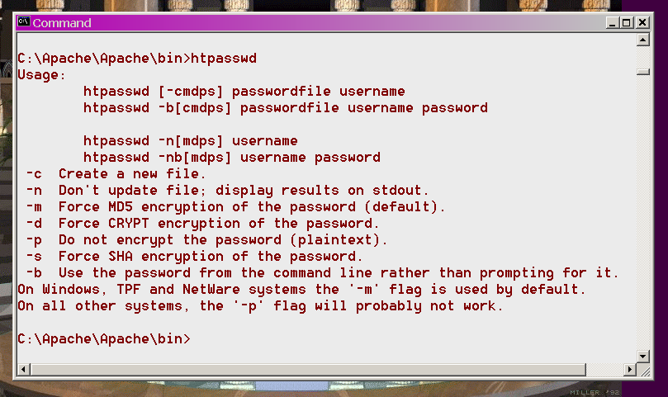
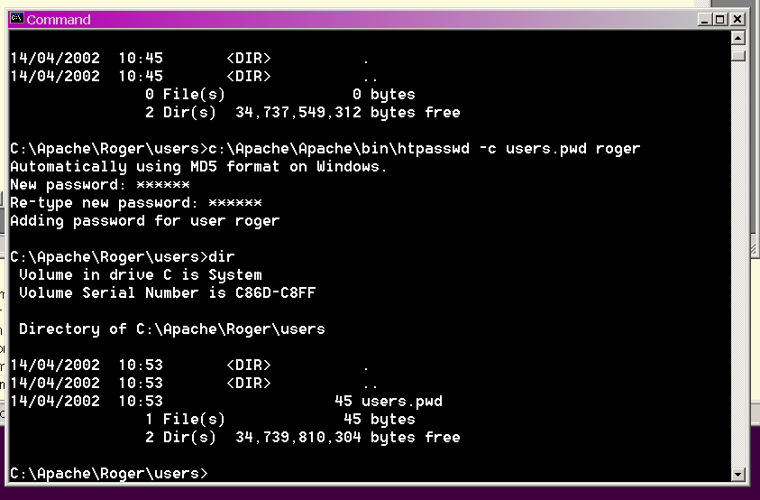
htpasswd: examples of use

Slide 12
Anonymous access
Needs module mod_auth_anon
Permits access via a "guest" user id with a password of user's email address
You should publish a privacy policy in respect of your use of these emails

Slide 13
Example
<Directory "C:/WebRoot/downloads">
Anonymous guest anonymous guestuser
Anonymous_MustGiveEmail on
Anonymous_LogEmail on
Anonymous_VerifyEmail on
Anonymous_NoUserId off
Require valid-user
</Directory>

Slide 14
Search engine spider control (1)
"Robots" or "spiders" are automated clients used to traverse websites
Most used to gather information for search engines
e.g. Google
Reasons to keep spiders out (of all or part of site):
It is incomplete
It is private
It is time sensitive (i.e. the contents will be rapidly out of date)
It is dynamically generated
Bad spiders may hit too fast and block user access

Slide 15
Search engine spider control (2)
Most spiders/robots will voluntarily adhere to your robot policies
Bad spiders will ignore it so it is not a guarantee of protection
A file robots.txt in the DocumentRoot directory (e.g. htdocs) controls robot behaviour
See http://www.robotstxt.org/wc/norobots.html for details of the standard

Slide 16
Example robots.txt
User-agent: WebCrawler
User-agent: excite
Disallow: /cgi-bin
Disallow: /private
Allow: /
User-agent: *
Disallow: /

Slide 17
Logging access
Generating access logs is usually a component of any security policy:
Why?
Who looks at them?
Authority part of your policy?
How long to keep?
Use of tools to extract statistics
Should logs include user identifiers?

Slide 18
Security of CGI scripts
Main recommendation – only enable CGI if needed
CGI issues:
Do you allow users to install their own CGI scripts?
What user does the CGI script run as?
Use a CGI wrapper – suEXEC or CGIwrap
Keep the patch level monitored – Open Source CGI scripts regularly updated

